Slide 1
STS Dual Pump - Technical Design

Slide 2
Overview
Overview
STS Changes
MTO Changes
Maintenance User/Calibration Changes
KC Changes
KOKO Admin Changes
Grafana Changes

Slide 3
Overview
Controller
App
KOKO Core
/sts/details api to get pump setup
pump setup response
dispense (pump_number)
Completed_dispense (pump_number)
/fuel-dispensed with additional pump_number
disable_pump (pump_number)
enable_pump (pump_number)
heartbeat (p1_status, p2_status)
heartbeat (p1_status, p2_status)
‹#›

Slide 4
STS Controller Changes
Disable Pump
Define new command to disable a pump
disable_pump {pump_number}
Response: completed_disable_pump
Enable Pump
Define new command to enable a pump
enable_pump {pump_number}
Response: completed_enable_pump
An event PUMP_STATE_CHANGED will be generated from the controller whenever the state of any pump changes. We’ll capture pump_number and state change in additional details

Slide 5
STS Controller Changes
Dispense API
Add pump number as a parameter to dispense_vol command
dispense_vol {volume ml} {token} {cents per litre} {pump_number}
Controller will dispense with the pump associated with the pump number.
pump_number will be stored on EEPROM together with other dispense data points.
If pump pump_number is disabled:
completed_dispense message will be sent back immediately with status code 5
Completed Dispense API
Add pump number to completed_dispense response
completed_dispense [token] [status_code] [vol_ml] [cost_cents] [time_ms] [tank_level_ml] [min_flow_rate] [max_flow_rate] [pump_number]
Pump number will also be part of recovered dispense data
Pump | Pump number
Pump 1 | 1
Pump 2 | 2

Slide 6
STS Controller Changes
Heartbeat String
Add state of each pump to the heartbeat string
Keys: P1 and P2 for pump 1 and pump 2 respectively
Values: EN and DS for enabled and disabled respectively

Slide 7
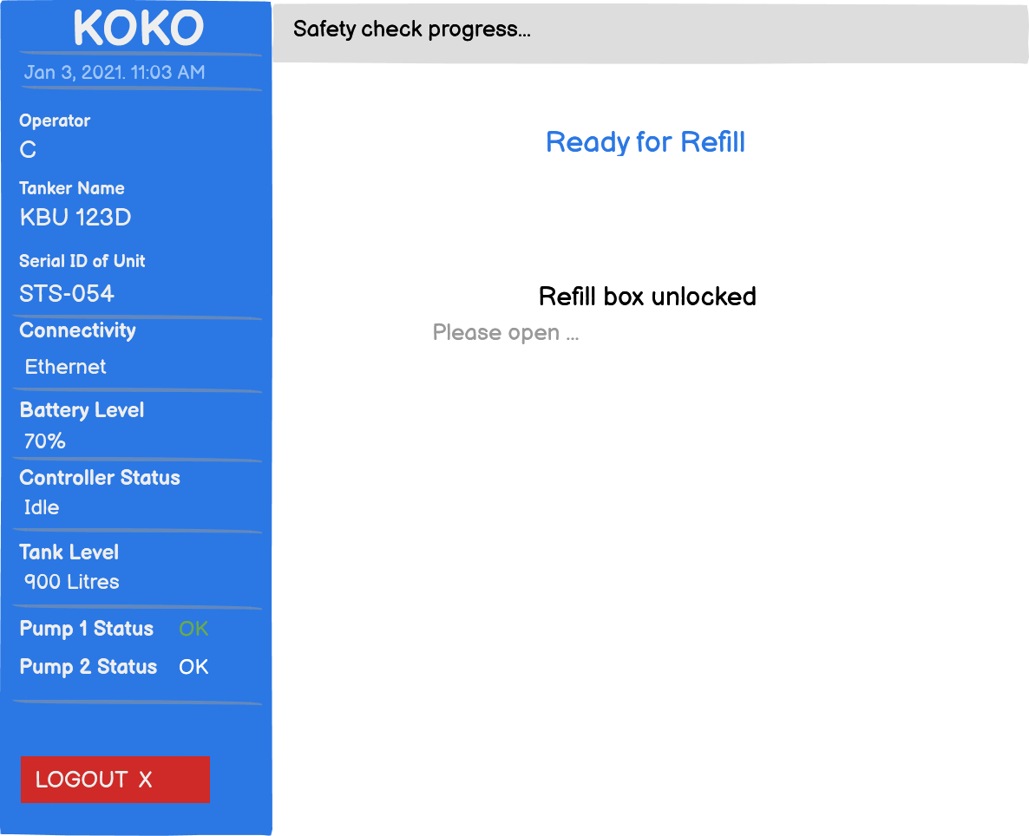
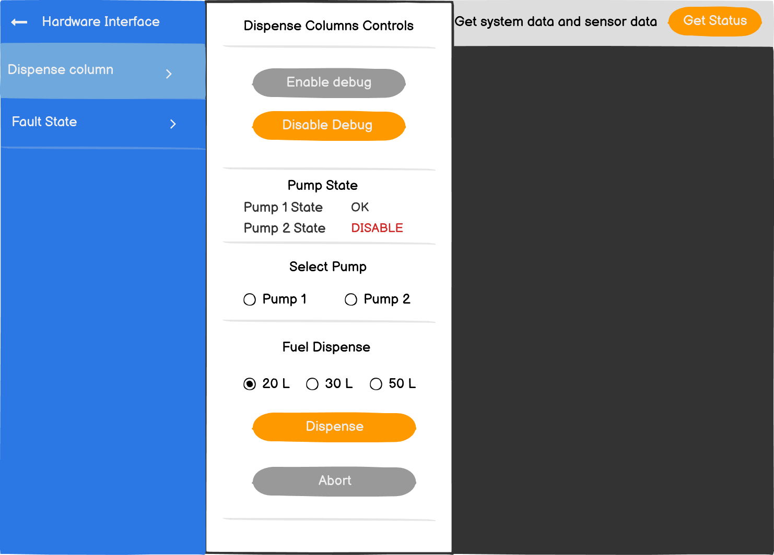
STS App Changes
Fetching Pump Information
Get pump_setup from v2/sts/details
Pump 1
Pump 2
Pump 1 and 2
Pump setup response will be used to display pump name and status on refilling screens and maintenance interface

Slide 8
STS App Changes Contd..
/v2/sts/fuel-dispensed request
{
….,
“pump_number”:2
}
Publishing Dispense Data
Include pump number used for any dispense in v2/sts/fuel-dispensed endpoint
Marking a pump as disabled
An operator can disable a pump when they get a hardware error 092 on the refilling screen
STS will use controller command disable_pump {pump_number}
Marking a pump as enabled
A maintenance user can enable a pump from the maintenance interface
STS will use controller command enable_pump {pump_number}

Slide 9
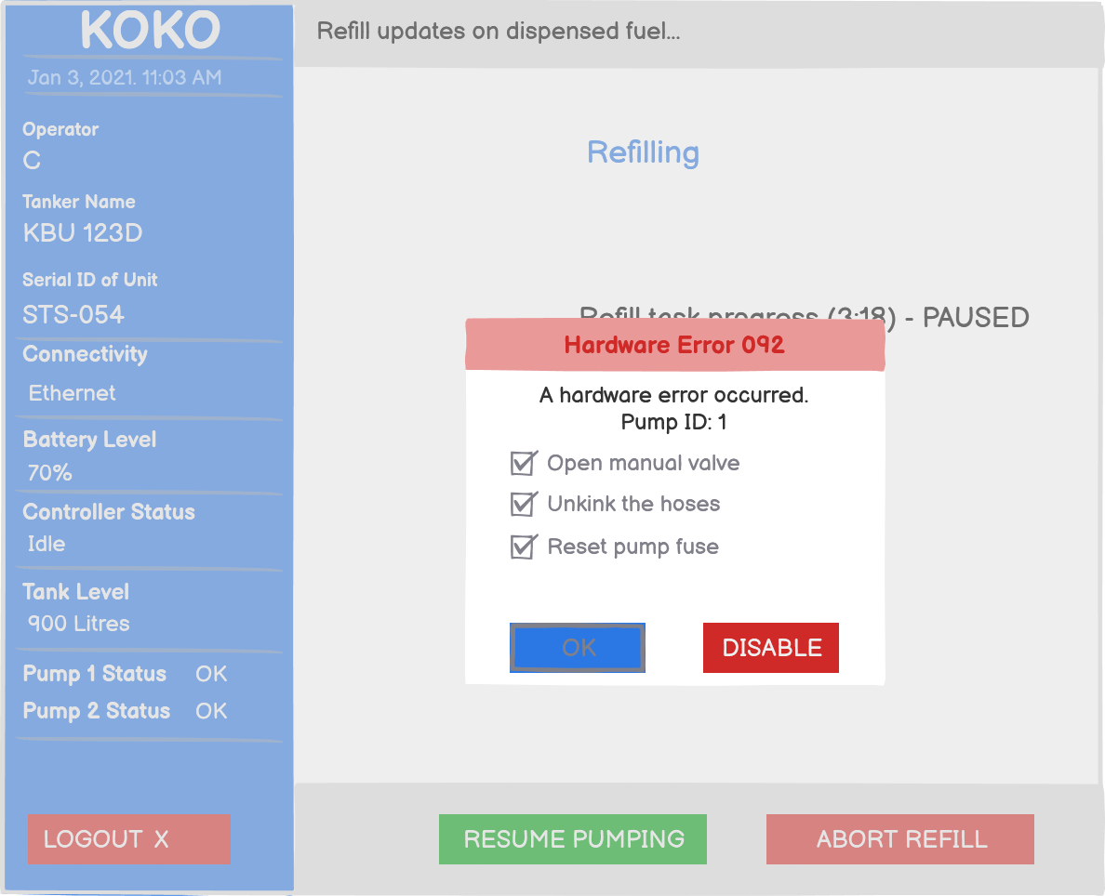
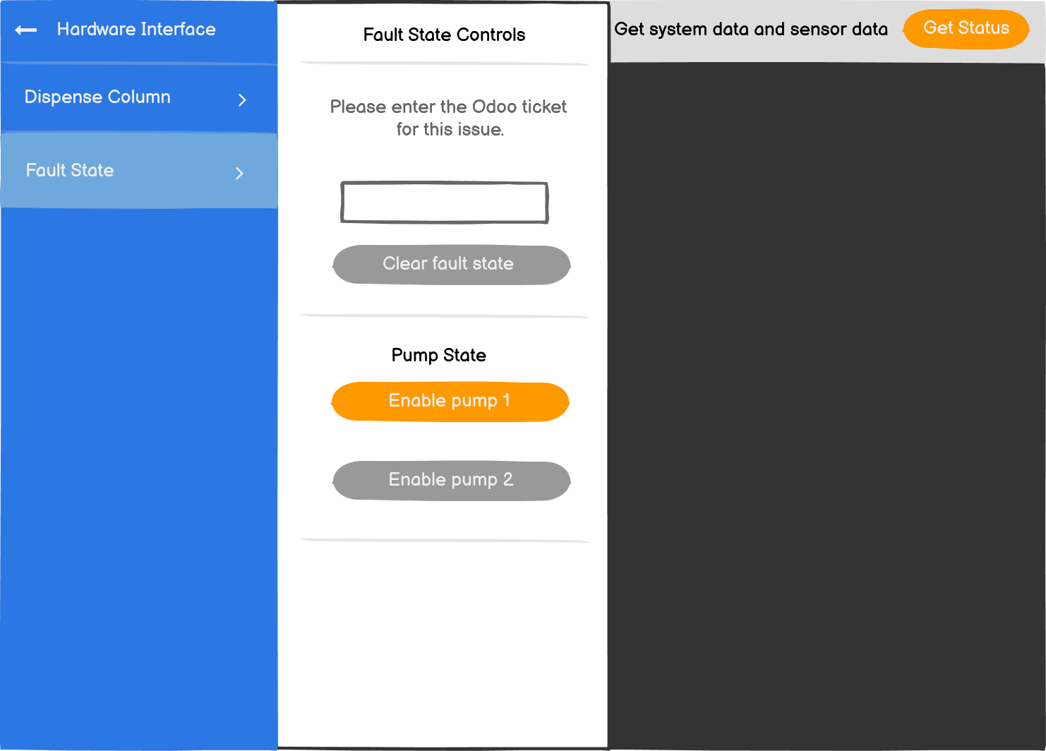
STS App Changes Contd..
Disabling a pump
Enabling a pump

Slide 10
KC Changes
API Changes
/sts/details
{
pump_setup: ‘Pump 1/Pump 2/Pump 1 and 2’
}
/v2/sts/fuel-dispensed(pump id in the request parameter)
Pump id will be received for every dispense and KC will store it against micro_tanker_dispenses table
{
…,
pump_number: 1/2
}
/sts/heartbeats
controller_data
ctr_pump1_state: EN/DS
ctr_pump2_state: EN/DS

Slide 11
KC Changes (Cont.)
Database Changes
micro_tanker
unit_version(v6.1/v6.2)
pump_setup(Pump 1/Pump 2/Pump 1 and 2)
micro_tanker_dispenses
pump_number: 1/2
micro_tanker_heartbeat
ctr_pump1_state: ‘EN’
ctr_pump2_state: ‘DS’
micro_tanker_status
ctr_pump1_state: ‘EN’
ctr_pump2_state: ‘DS’
Enums
PumpSetup
pump_1: ‘Pump 1’
pump_2: ‘Pump 2’
pump_1_and_2: ‘Pump 1 and 2’
PumpState
enable: ’EN’
disable: ‘DS’
FuelDeviceEventCode
PUMP_STATE_CHANGED = 494

Slide 12
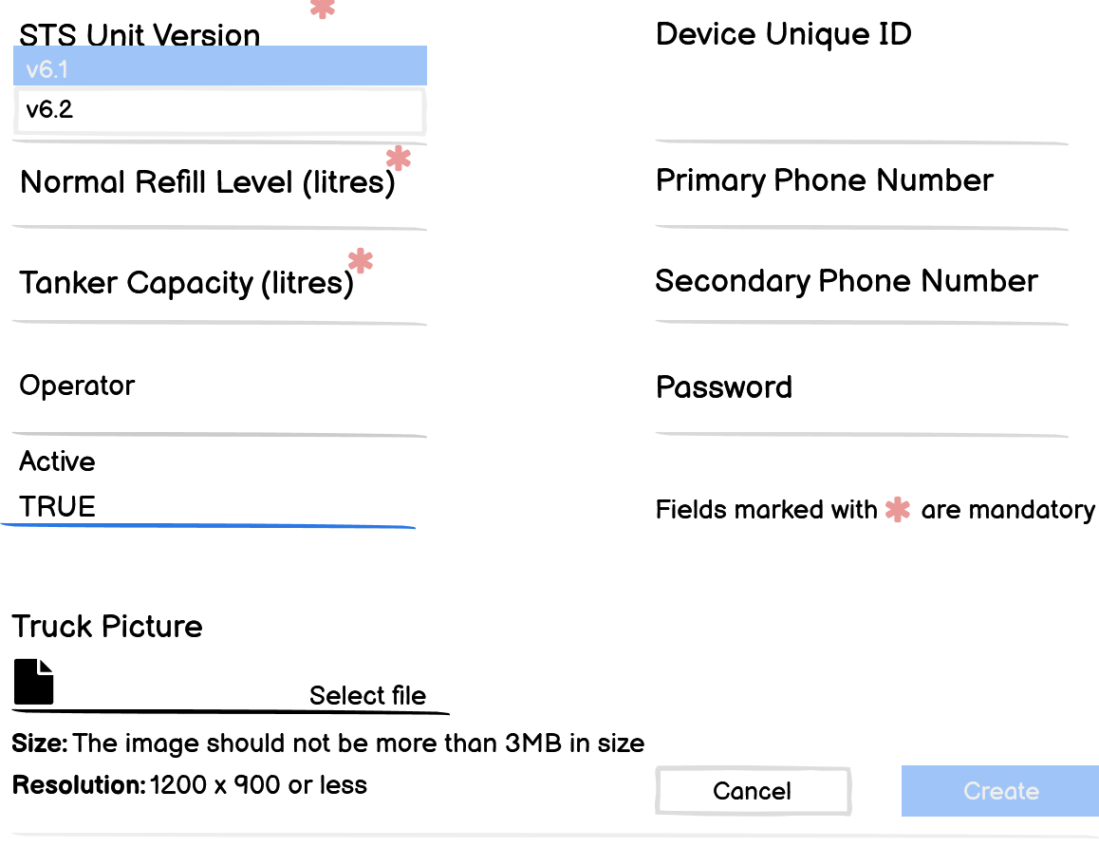
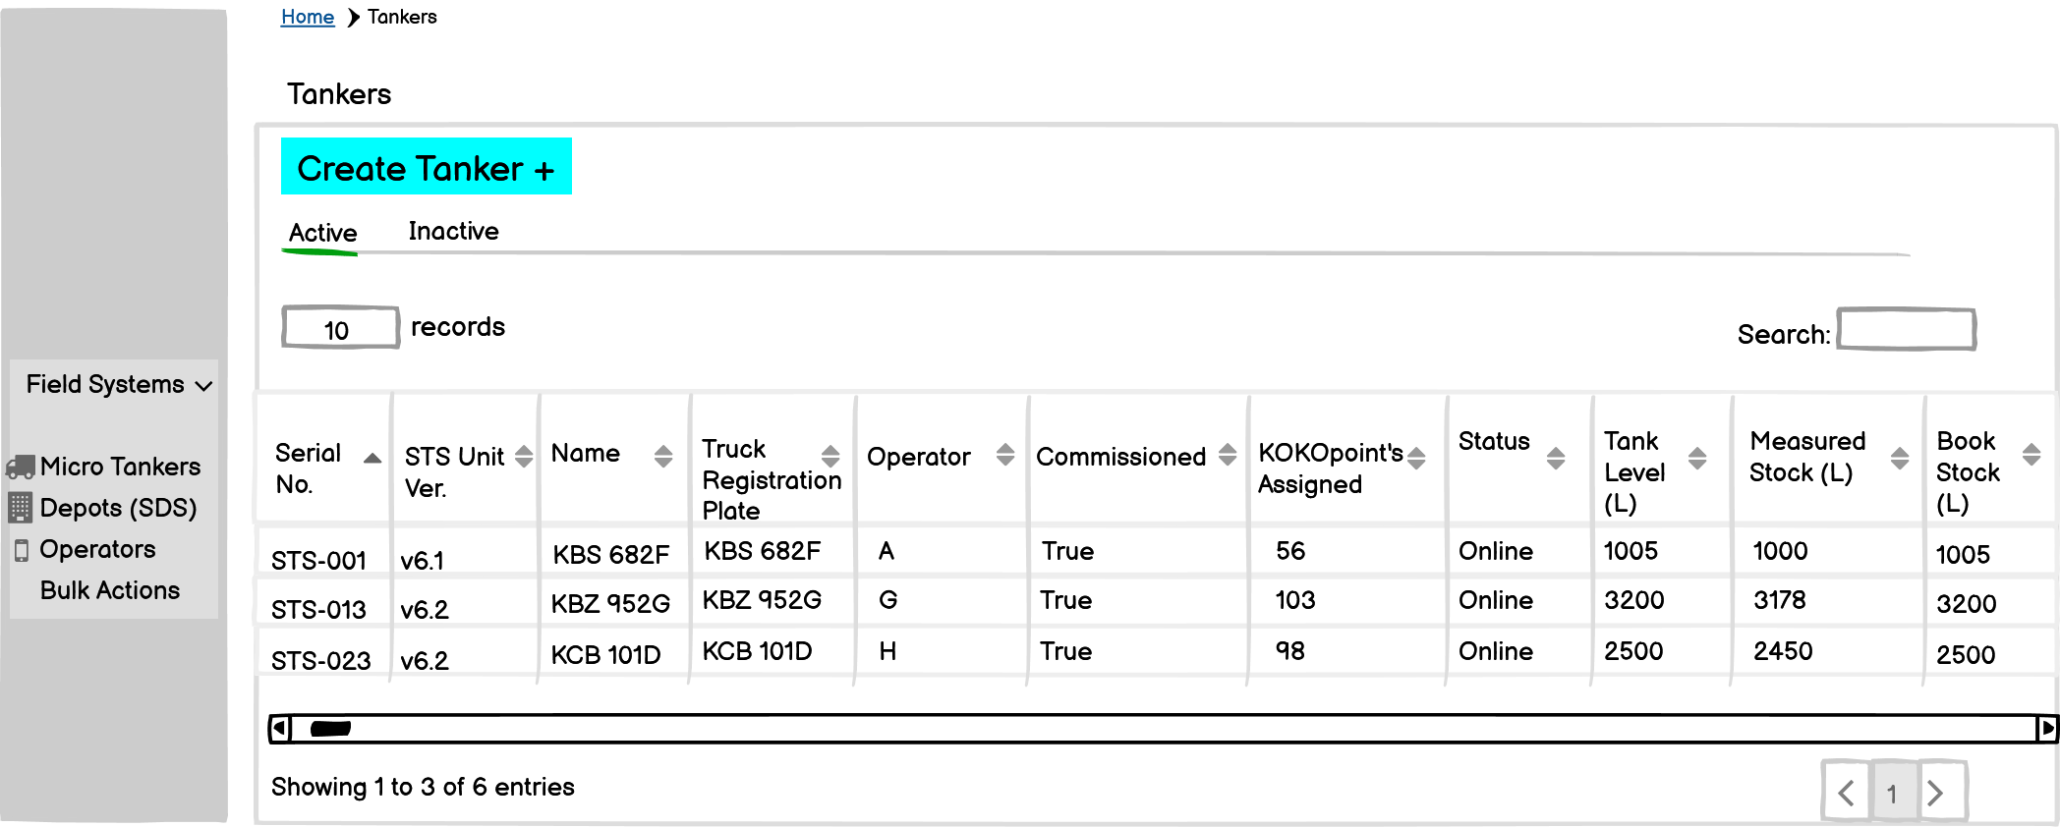
KOKO Admin Changes
Creation
Introduce STS Unit version while creation of STS
Pump Setup enable/disable will be visible for STS Unit version v6.2 only
Configuration
STS Unit version will be readonly
Pump Setup will be configurable
Status
Show Pumps State(Using heartbeat Enable/Disable)
List View Page
Show STS Unit version

Slide 13
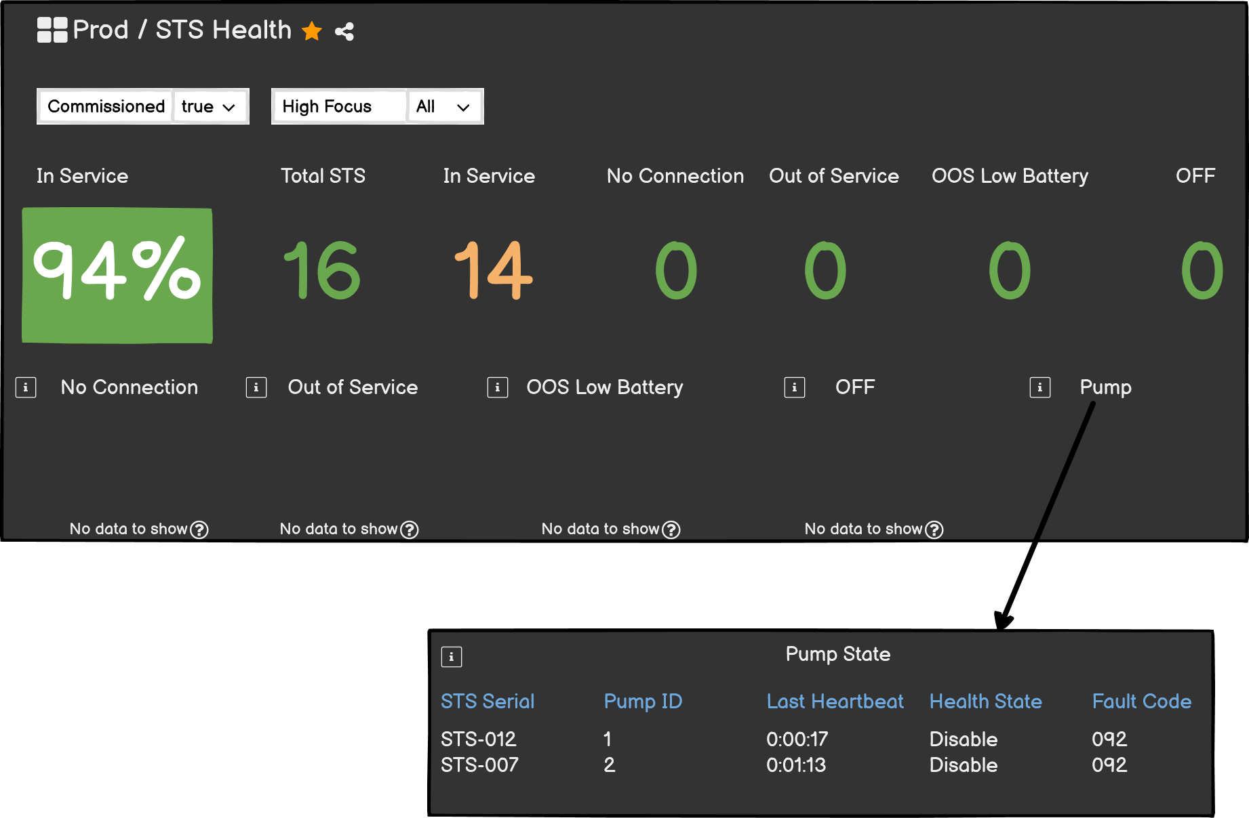
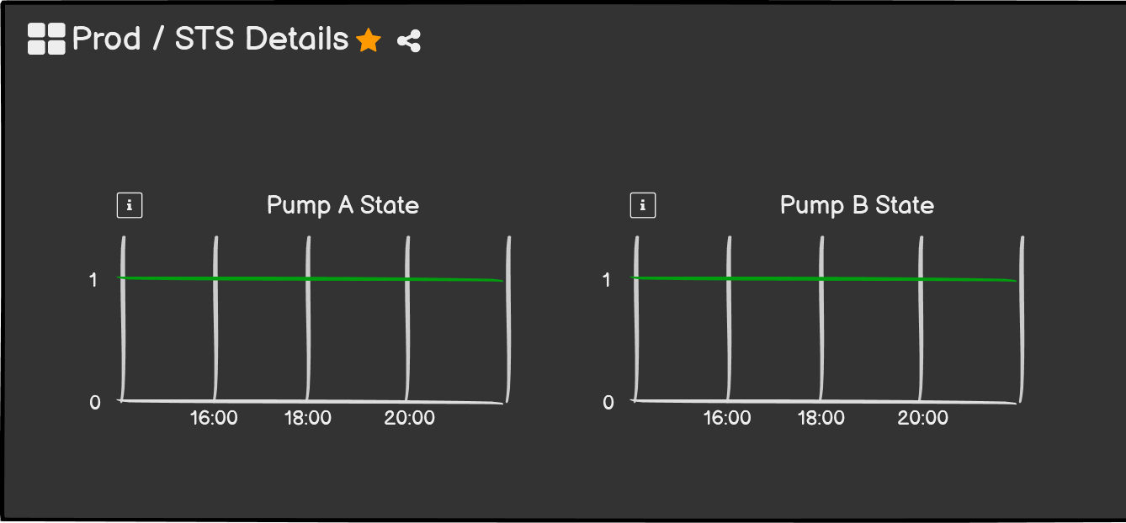
Grafana Changes
Create a new metric in STS Health Dashboard
Pump State
Will show all the fault pump state of the system with
STS serial Id
Pump Number
State
Create a new metric in STS Detailed Dashboard
Enable: 1
Disable: 0

Slide 14
Design Sign Off
Name | Date
Linda Agola | -30th April 2021
Micael | -

Slide 15
Thank you

